Slide 1
Mobile Application Development
Week: 1
Dr. Adnan Manzoor

Slide 2
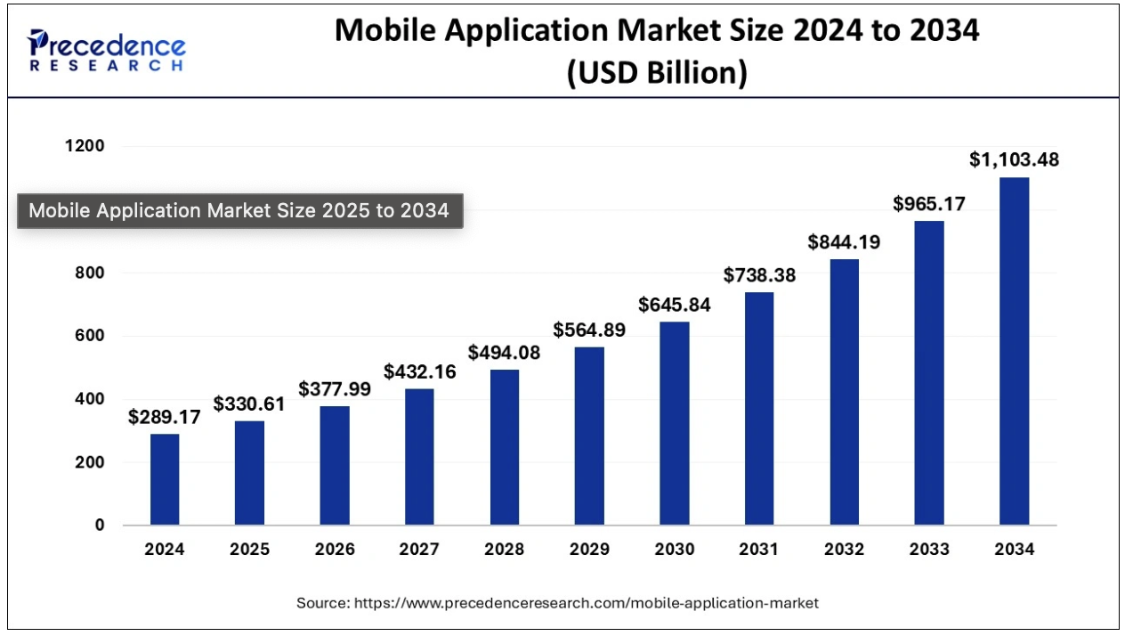
Notes:
The global mobile app development market is likely to expand at 14 % CAGR (Compound Annual Growth Rate) during the forecast period (2016-2022)

Slide 3
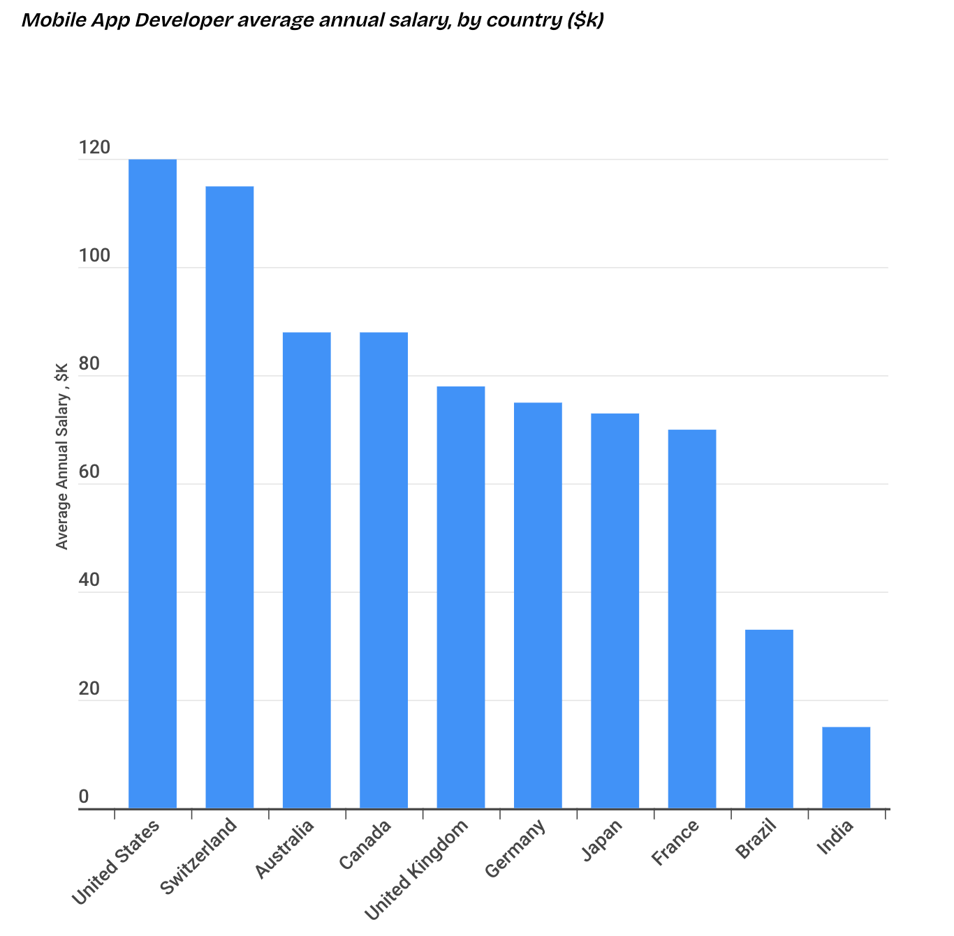
Mobile app developer annual salary, by country, in USD

Slide 4
Increasingly mobile, screen-oriented increasingly
Dominance of Screen-Based Media:
Average daily screen time is now 6 hours 40 minutes globally; 7 hours 3 minutes in the U.S. (Source: Exploding Topics, 2023)
Leisure Screen Time:
Consumers spend over 3.5 hours daily on smartphones, with additional time on TVs and laptops. (Source: DataReportal, 2023)
Simultaneous Device Use:
70% of users multitask on two or more devices, with the most common combinations being smartphone + TV and laptop + smartphone. (Source: Statista, 2023)

Slide 5
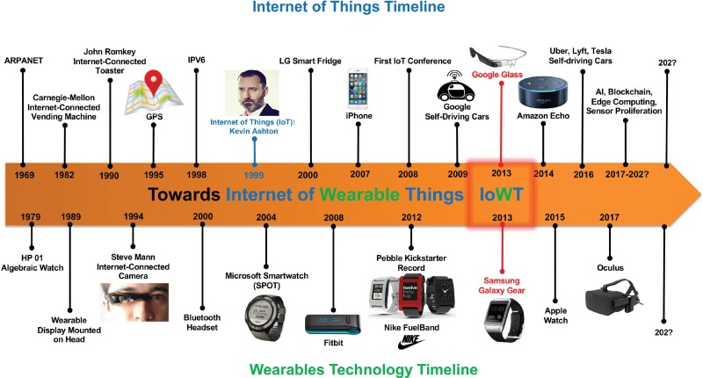
Wearable Devices

Slide 6
What are Smart Wearable Devices
The IoT has the potential to connect billions and billions of “things” to the Internet by 2022, ranging from bracelets to cars
Breakthroughs in the cost of sensors, processing power and bandwidth to connect devices are enabling ubiquitous connections already.
Future adoption: Connected Wearable Devices, Connected Cars, Connected Homes, Connected Cities, and the Industrial Internet.
Early simple wearable products like fitness trackers and activity monitors are already gaining traction. More than 520 million such devices were on the market at the end of 2023, 40% are fitness trackers, 40% lifestyle/ computing, 10% healthcare adoption.
New Smart Wearable Devices being launched everyday.
Notes:
The Industrial Internet is the integration and linking of big data, analytical tools and wireless networks with physical and industrial equipment, or otherwise applying meta-level networking functions, to distributed systems.

Slide 7
Android Overview
A software stack for mobile device
Developed and managed by open Handset Alliance
Open-sourced under Apache License
Notes:
The Open Handset Alliance is a consortium of 84 firms to develop open standards for mobile devices.
Linux Middleware: Android libraries and Android runtime, and Android Framework
kerrnel: which essentially deals with the underlying hardware
Application layer: this is where the user encounters the Android platform.
Google and Android are two different things

Slide 8
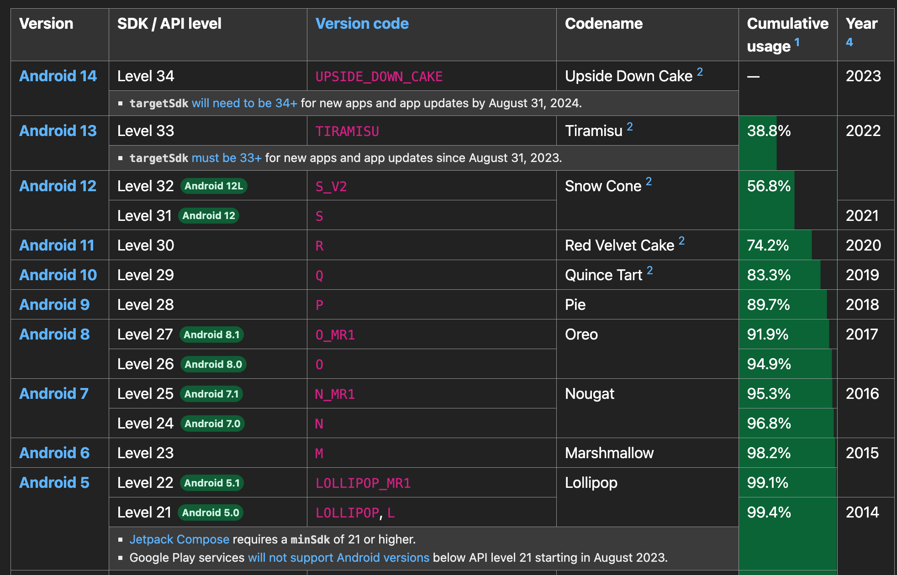
Android Platform Versions
Moving target, new platforms released regularly
Notes:
It all started in 2008, so close to a decade ago, looking at today's date.
What started out as a small company which was developing Android,
which was later acquired by Google.
And then the first version of Android, which
was a base version-- there were no actual devices released for that-- that
was made available in September 2008.
Thereafter, the first usable version was Android Cupcake,
which came into April 2009.

Slide 9
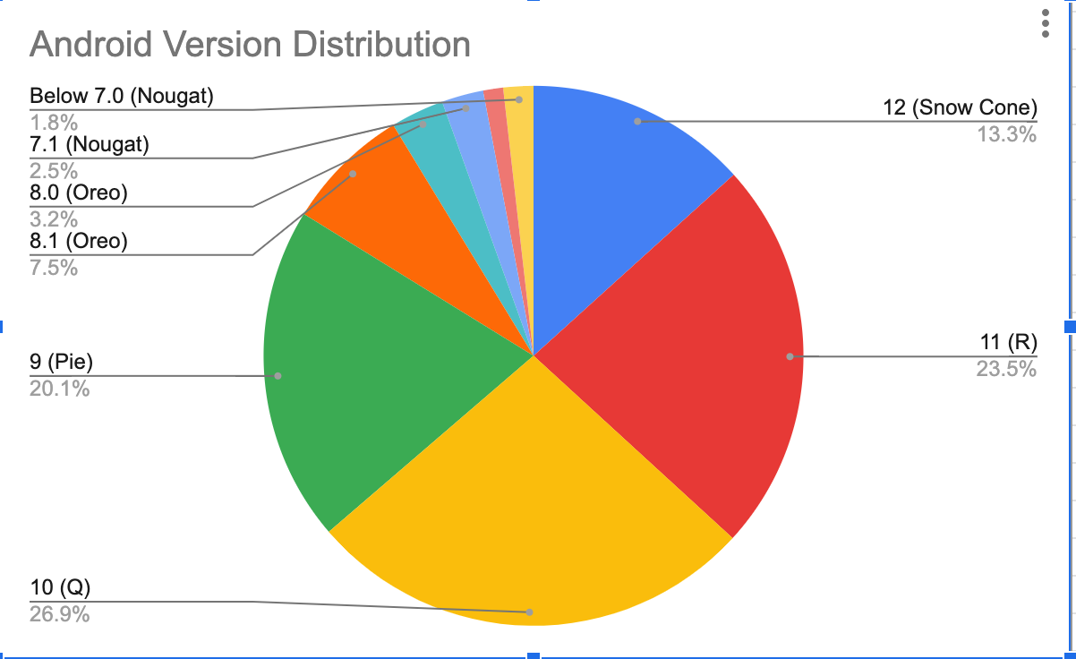
The relative number of devices running a given version of the Android platform (January 6, 2023)

Slide 10
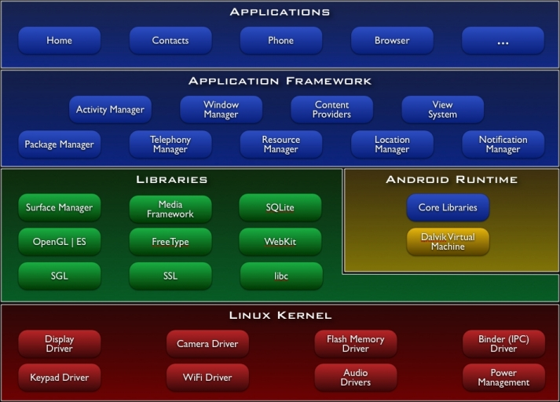
Android Architecture
Notes:
Android Aplication framework: Now, below the application layer, of course, you have the Android Application Framework.
So when you develop your applications, you will be making use of the API that the Android Application Framework exports for you to make use of.
Libraries: These libraries are typically implemented in C and C++.
Android Runtime: Java virtual machine optimized for mobile platform environment
Older verions (Jellybeans) used to have a machine called Dalvik Virtual Machine

Slide 11
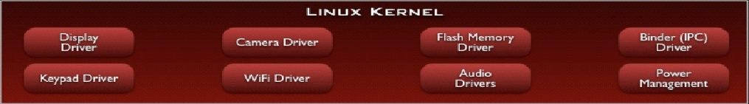
Linux Kernel
Device drivers
Memory management
Process management
Networking
Notes:
Linux Kernel Layer Android is based on Linux kernel, and this layer provides the drivers for the various hardware of Android devices, for example, display driver, audio driver, camera driver, blue-tooth driver, Wi-Fi driver, battery management, etc.

Slide 12
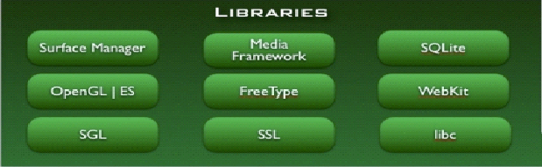
Libraries
C/C++ libraries
Interface through Java
Surface manager – Handling UI Windows
2D and 3D graphics
Media codecs, SQLite, Browser engine
Notes:
System Libraries Layer
This layer provides primal support to the system with some C/C++ libraries. For example, SQLite provides database support for the database, OpenGL/ES provides support for 3D graphics, Webkit lib provides support for browser kernel, etc.

Slide 13
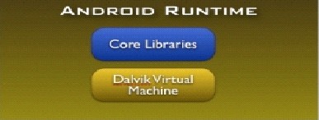
Android Runtime
ART has two main features compared to Dalvik:
Ahead-of-Time (AOT) compilation, which improves speed (particularly startup time) and reduces memory footprint (no JIT)
Improved Garbage Collection (GC)
Core Libraries
Java 8/11/17 Std edition
Collections, I/O etc…
Notes:
Android runtime is also in this layer, which provides some core libraries to allow developers to develop Android apps with Java. The Dalvik virtual machine is also in the runtime (replaced with ART after version 5.0), and it allows the apps to run in their own processes and have their own virtual machine instances. Compared with Java virtual machine (JVM), Dalvik and ART have been specifically optimized for mobile devices which usually have less memory and computing power.

Slide 14
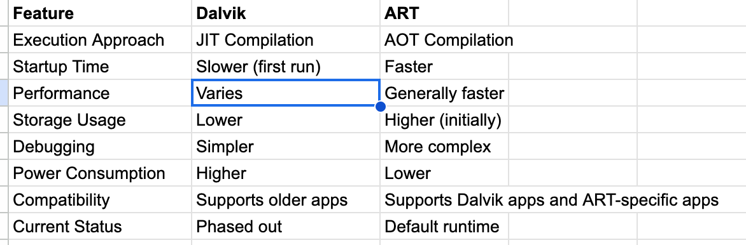
Android Runtime
Notes:
Android runtime is also in this layer, which provides some core libraries to allow developers to develop Android apps with Java. The Dalvik virtual machine is also in the runtime (replaced with ART after version 5.0), and it allows the apps to run in their own processes and have their own virtual machine instances. Compared with Java virtual machine (JVM), Dalvik and ART have been specifically optimized for mobile devices which usually have less memory and computing power.

Slide 15
Benefits and Drawbacks of ART
Apps run faster as DEX bytecode translation done during installation.
Reduces startup time of applications as native code is directly executed.
Improves battery performance as power utilized to interpreted byte codes line by line is saved.
Improved garbage collector.
Improved developer tool.
App Installation takes more time because of DEX bytecodes conversion into machine code during installation.
As the native machine code generated on installation is stored in internal storage, more internal storage is required.
Notes:
Dex bytecode, short for Dalvik Executable bytecode, is a specific type of bytecode used by the Android platform. It plays a crucial role in how Android apps are executed on devices.

Slide 16
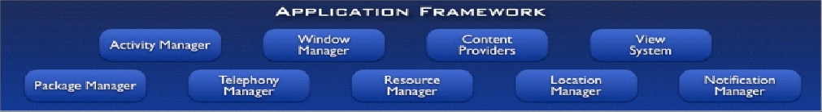
Application Framework
API interface
Activity manager – manages application life cycle.

Slide 17
Applications
Built in end user apps
Can replace built in apps

Slide 18



.apk package
Android Applications
Android applications are written in Java and Kotlin
The compiled Java code (along with any data and resource files required by the application) is bundled by the aapt tool into an Android package (.apk)
Data files
Java classes
Resources
Notes:
Android Asset Packaging tool
Android Package Kit
Kotlin is interoperable with Java, so you should not run into any issues.

Slide 19















Application Components
Four basic components: Activities, Services, Broadcast Receivers, Content Providers
Activities
Services
Application Components
Broadcast Receivers
Content Providers

Slide 20
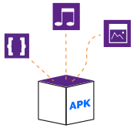
WHAT IS AN APP?
App is an abbreviation of application.
Apps are software programs that are executed in a computer, smartphone or other device.
The most common use for the term app is to denominate software programs that run on smartphones or mobile devices.
Notes:
In this course we have discussed many things about apps. But, what is an app? App is an abbreviation of application. Apps are software programs that are executed in a computer, smartphone or other device. The most common use for the term app is to denominate software programs that run on smartphones or mobile devices.
As we discussed previously, apps form part of Android's architecture. In Android, apps contain compiled Java code, data files and resources files used by each app. All of this comes packed up in a file denominated Android Application Package (APK), with extension .apk. APKs are a variants of Java's JAR format.

Slide 21
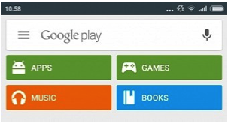
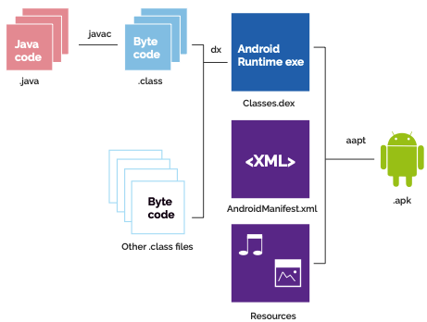
WHAT IS AN APP?
Notes:
Apps are packaged by using the tool AAPT (Android Asset Packaging Tool) which is included in Android SDK. To package an application, Java code is compiled, then, compiled libraries are also included and all the code is optimized so it can be executed in Android RunTime. Also, the package includes files of data and resources such as images, media files, xml, etc. An important file that is also included is the AndroidManifest.xml; we will cover its importance later on.
In Android, APKs are distributed and managed through Google Play mainly but it also supports the installation directly on the device by using .apk files.

Slide 22
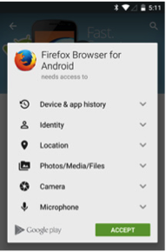
ANDROID APP PERMISSIONS
Are used to represent a (single) screen with a user interface.
Activities are a fundamental part of applications, in which the user interacts with the application.
Each activity is assigned a window.
Usually a window uses up all of the available screen, but it can also be smaller and the screen will display several activities.
Notes:
Android implements the principle of minimal privileges. This means that applications by default only access to components they need to execute the application and nothing more. Applications do not have permissions to access other parts of the system and this creates a safe execution environment.
However, sometimes applications need to access system services or access data from other applications. To achieve this, there are some alternatives and being the most commonly used to ask the user for permission to access data or use peripherals of the device. For example, any developer must ask permissions to access text messages, camera, gps, etc.
That is why when applications are installed or updated, a window pops up where the user is prompted to authorize the explicit permissions over services or peripherals of the device. If the user refuses to accept these requests, the application is not installed.

Slide 23
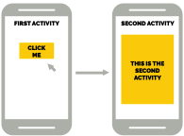
Application Components (Activity)
Are used to represent a (single) screen with a user interface.
Activities are a fundamental part of applications, in which the user interacts with the application.
Each activity is assigned a window.
Usually a window uses up all of the available screen, but it can also be smaller and the screen will display several activities.

Slide 24
Application Components
Each activity is independent. For this reason, an activity may be initiated from a different application if it is allowed.
In order to implement an Activity, a class must inherit from the class Activity. This will be explained later on.

Slide 25
Application Components (Services)
Services are used to perform prolonged tasks or tasks for remote processes in the background.
Services do not have a graphical interface.
A service is implemented as a subclass of Services.

Slide 26
Application Components (Broadcast Receivers)
Broadcast Receivers are used to perform specific tasks when a system wide broadcast is detected.
Some of these broadcasts are originated by the system.
For example: incoming calls and sms, low battery, network state changed, image captured, etc.
Broadcast receivers are different to services in several ways but mostly because broadcast receivers wait for an event in order to run.
To implement a broadcast receiver, developers must inherit from the class BroadcastReceiver.
Notes:
Broadcast Receivers also lack of a graphical interface and are generally used to display alerts or notifications to the users.

Slide 27
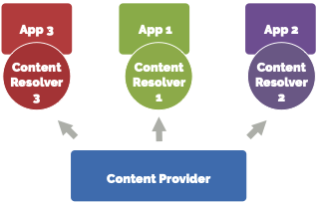
Application Components (Content Providers)
Content Providers manage access to a structured set of data.
Can be stored on the file systems or SQLite database
The main characteristic of the content providers is that they can share this data between applications.
Content providers provide an encapsulated access to data.
Notes:
For example, the contact list is held in a content provider and for this reason, external applications such as Whatsapp or the sms app can access contacts.
A Content Provider is implemented as a subclass of ContentProvider and must implement standard set of APIs that enable other apps to perform transactions.

Slide 28
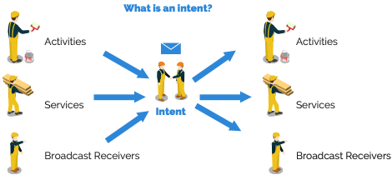
ADDITIONAL ELEMENTS OF AN APPLICATION (INTENTS )
Notes:
Intents are asynchronous messages that send activities, services and broadcast receivers. The most common use of intents is to move from one activity to another, for example, when a user clicks a button to launch the next activity. It is possible to pass information, including objects, from one activity to another. Intents can also open other Android applications. Because this is a very important part of Android, we will review it more in depth later in the course.

Slide 29
ADDITIONAL ELEMENTS OF AN APPLICATION (ANDROID MANIFEST)
Notes:
The app's package name, which usually matches your code's namespace.
The components of the app, which include all activities, services, broadcast receivers, and content providers.
The permissions that the app needs in order to access protected parts of the system or other apps.
The hardware and software features the app requires, which affects which devices can install the app from Google Play.

Slide 30
ADDITIONAL ELEMENTS OF AN APPLICATION (ANDROID MANIFEST)
Every Android app must include an AndroidManifest.xml file describing functionality
The manifest specifies:
App’s Activities, Services, etc.
Permissions requested by app
Minimum API required
Hardware features required, e.g., camera with autofocus
External libraries to which app is linked, e.g., Google Maps library
Notes:
The app's package name, which usually matches your code's namespace.
The components of the app, which include all activities, services, broadcast receivers, and content providers.
The permissions that the app needs in order to access protected parts of the system or other apps.
The hardware and software features the app requires, which affects which devices can install the app from Google Play.

Slide 31
ADDITIONAL ELEMENTS OF AN APPLICATION (APP RESOURCES )
In the user interfaces, beside the use of text, button and other inputs,
sometimes they can require other resources such as images, animations, colors and styles.
Inside the application project there is a folder named "res" where all of these resources must be placed.

Slide 32
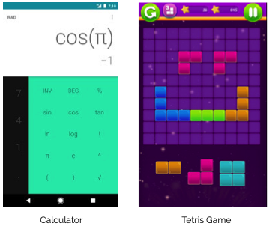
BASIC KINDS OF APPS: FOREGROUND APPLICATIONS
These apps have a graphical interface that is executed while the user is using it.
As soon as the app closes, these stop their execution.
When a user exits the application and this is not closed, the app is suspended and uses less resources.
All this process is part of the activity lifecycle that we will review later on.
Notes:
Suspended apps can be cleaned up by Android’s resource management and this happens as a last resource when the device is running low on memory. All this process is part of the activity lifecycle that we will review later on.

Slide 33
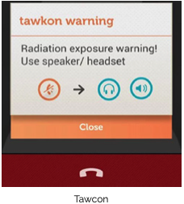
BASIC KINDS OF APPS: BACKGROUND SERVICES
Are applications that are executed in the background in a silent manner.
They have little or no interaction with the user.
This type of applications usually wait for an event to be generated by any hardware peripheral or any message received in order to make an action.
Notes:
Even though it is possible to create applications that are silently executed in background and are invisible for the user, it is preferred that the user can control these processes. Services is another topic that will be reviewed more in depth later in the course.

Slide 34
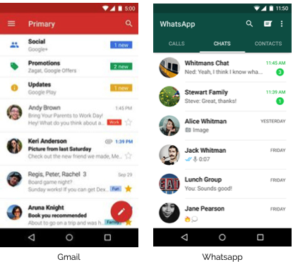
BASIC KINDS OF APPS: INTERMITTENT APPLICATIONS
Intermittent applications are a combination of the two previous types.
When developing this types of applications developers must consider all of the application states
This is very important because it can prevent undesired behaviors such as displaying app notifications when the app is running.
Notes:
Intermittent applications are a combination of the two previous types. They are applications that have a graphical interface where the user can interact with the app, but also listens in the background for events. An example of this type of applications are chat applications, where the user can receive messages even though the app is closed and can also open the app and read all of the messages received. When developing this types of applications developers must consider all of the application states. This is very important because it can prevent undesired behaviors such as displaying app notifications when the app is running.

Slide 35
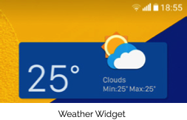
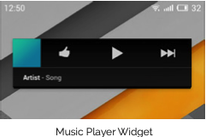
BASIC KINDS OF APPS: WIDGETS
They are applications that have a small graphic interface within the user’s home screen and are also known as mini-apps.
The user can interact with the widget without the need of opening the app. Widgets are commonly used to display information to the user, for example: weather, battery percentage, news, emails, etc.
Notes:
They are applications that have a small graphic interface within the user’s home screen and are also known as mini-apps. The user can interact with the widget without the need of opening the app. Widgets are commonly used to display information to the user, for example: weather, battery percentage, news, emails, etc. Widgets can be static or dynamic. A widget can also perform actions to control hardware peripherals. A user can move widgets through the launcher’s home pages or change their size if the widget supports it.

